Slide 1


Designing a Chatbot using Cornell Movie-Dialog Corpus Dataset
Team 3
Cesar Lucero Ortiz
Akram Mahmoud
Jeremy Cryer
October 23,2023
Notes:
Slide 1: Title Slide
Title: "Building a Movie-Dialog Chatbot"
Subtitle: Journey through Design, Challenges, and Improvements
Presenter's Name and Affiliation

Slide 2
Team Contributions
Cesar Lucero
Bulk of software was generated by Cesar.
Including text preprocessing, model training, and model testing.
Report development/support
Akram Mahmoud
Developing presentation
Consolidating report information to present.
Jeremy Cryer
Coding and brainstorming support.
Critiquing and code clean up.
Report development
Notes:
Contributions of members

Slide 3
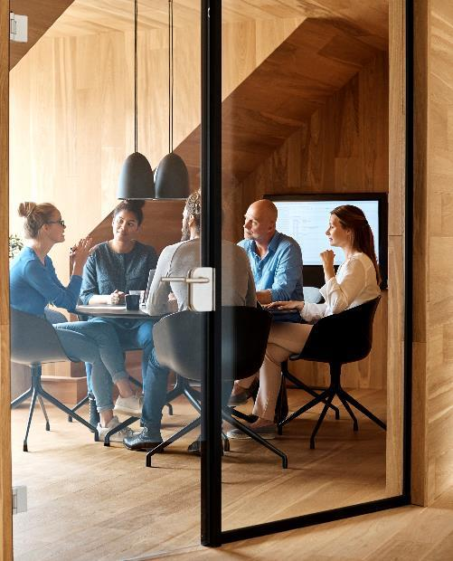



Introduction
Goal: Create and train a chatbot using a given data set.
Notes:
"Our project aims to create a chatbot capable of comprehending the Cornell Movie-Dialog Corpus data obtained from Kaggle. Chatbots and natural language processing have become increasingly important in various applications, making this project highly relevant.“
Slide 2: Introduction (3-5 minute)
"Good [morning/afternoon/evening], everyone. Today, we embark on a fascinating journey into the world of chatbots, specifically one designed to comprehend the Cornell Movie-Dialog Corpus data. But first, what is a chatbot?"
Start by defining a chatbot based on the article: "In the context of our project, a chatbot is a computer program designed to simulate human conversation, aiding users in resolving queries and issues."
Discuss the growing importance of chatbots in various industries and applications.
Provide real-world examples of where chatbots are currently in use.
Explain why chatbots are valuable, emphasizing their potential to enhance customer service and user experiences.
------------------------------
1. What is the goal of the project.

Slide 4

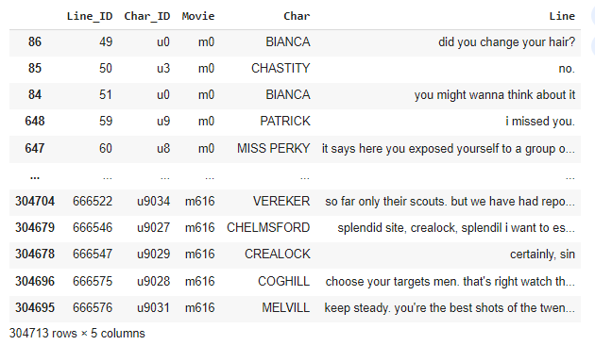
Dataset Overview
Cornell Movie-Dialog Corpus dataset.
Movie_lines.txt
Notes:
"Let's begin by taking a closer look at the Cornell Movie-Dialog Corpus dataset. It comprises a vast collection of movie-related dialogues, providing valuable conversational data for our chatbot development.“
Slide 3: What is a Chatbot? (1 minute)
Define a chatbot based on the article.
"A chatbot is a computer program that simulates human conversation to solve customer queries and assist users across various channels.“
Slide 4: Project Goal (1 minute)
Describe the project's goal.
"Our objective is to design a chatbot capable of comprehending the Cornell Movie-Dialog Corpus data obtained from Kaggle."

Slide 5
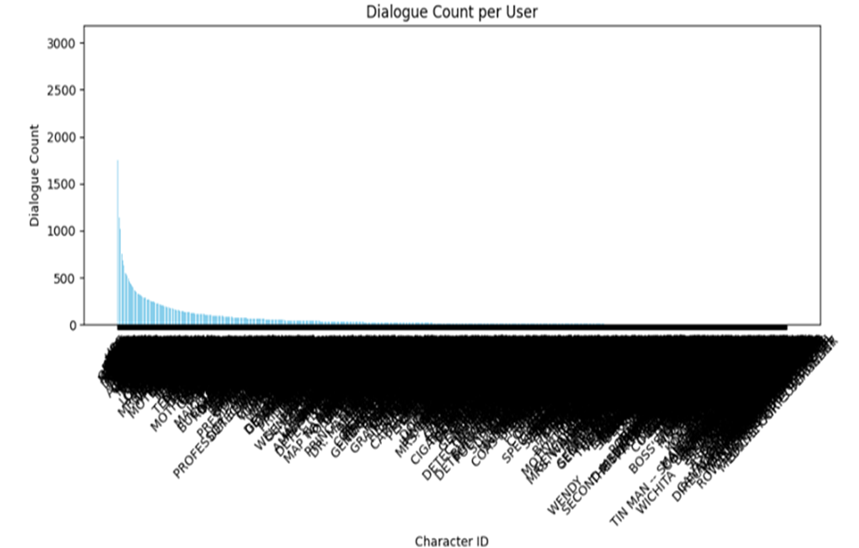
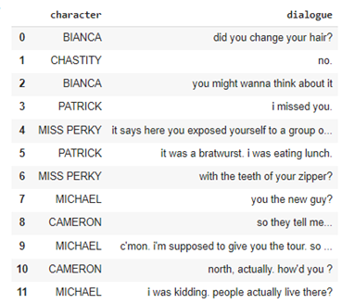
Data Preprocessing
Changing text to lower case
We kept stop words, and punctuation
Structuring dialogue (text grouping)
Notes:
"Data preprocessing was a critical step in cleaning and preparing the raw dialogues from the dataset. We applied tokenization and various techniques to ensure our model could effectively understand and generate responses.“
Slide 5: Data Pre-processing (3-5 minutes)
Describe the crucial role of data pre-processing: "Data pre-processing is the foundation of any successful chatbot project."
Explain the steps taken during data pre-processing, starting with dataset selection and the choice to use the movie-dialog dataset from Kaggle.
Dive deeper into specific pre-processing steps, such as data splitting, text normalization, and the decision to retain punctuation and stop-words.
Discuss the rationale behind these choices and their impact on the chatbot's performance.
Slide 6: Data Pre-processing (contd.) (3-5 minutes)
Shift the focus to character-based data analysis: "To better understand our data, we conducted character-based analysis."
Present Figure 1, the dialogue count per character graph, and elaborate on the insights gained from it.
Explain how the observed variations in data count per character informed subsequent decisions in the project.
Stress the importance of data analysis and visualization in data pre-processing.
Slide 7: Data Pre-processing (contd.) (3-5 minutes)
Continue the discussion on data pre-processing: "Now, as we prepared our data, we faced the challenge of reducing it to character-dialog pairs."
Introduce Image 1, showing structured dialog data display, and explain its significance.
Discuss the reasons for reducing the dataset and the role of structuring in streamlining data for the chatbot.
Emphasize how these choices impacted the overall efficiency of the chatbot's training and performance.
Slide 8: Data Pre-processing (contd.) (3-5 minutes)
Transition to the final aspect of data pre-processing: "The last crucial step was to group the data by character."
Explain the rationale behind grouping data by character and its potential influence on chatbot responses.
Discuss how this decision aligns with the project's goal of simulating character-specific conversation styles.
Highlight the semantic and sentiment variation expected from different characters in the chatbot's responses.

Slide 6
Model Selection, Training, and Fine-tuning
Model Selection
Training and fine-tuning
GPT2LMHeadModel
Corresponding Tokenizer
Huggingface transformer library
Lighter processing load
Trainer Object
Data Collator
Chatbot
Hyperparameters
Conversation Loop and Response Loop
Notes:
"During the training phase, we fed the preprocessed data into our model, fine-tuning it to improve performance. Transfer learning and fine-tuning methods were applied to make the model domain-specific.“
the GPT2LMHeadModel

Slide 7

Challenges Faced
BERT Model difficulty processing
Line sequencing
Notes:
"Throughout the project, we encountered several challenges, such as handling noisy data, ensuring diversity in responses, and optimizing computational resources. We'll discuss these challenges and how we addressed them.“
Slide 14: Challenges (2 minutes)
Discuss the challenge of inexperience in creating a chatbot, including the shift from BERT to GPT2.
Highlight the importance of research and understanding data format before model selection.
Slide 15: Challenges (contd.) (2 minutes)
Address the challenge of line sequencing inconsistencies.
Present Image 2 showing skipped line IDs.
Emphasize the need for cross-checking missing data in future iterations.

Slide 8


Future Improvements
Line sequencing understanding
More data (use of additional data parameters)
Post-processing (checks and balances)
Evaluation Metrics (BLEU and ROGUE)
Physical crosschecks
Notes:
"Looking ahead, there are several avenues for improving our chatbot. We recommend exploring scalability, enhancing accuracy in responses, and refining the user experience for a more seamless interaction."

Slide 9

Thank You
Notes:
Slide 18: Q&A (1 minute)
Open the floor for questions and discussions.

